Slide 1
Chapter 6- Requirements Management

Slide 2
Requirements management
The process of managing change to the requirements for a system.
The major concerns of requirements management are:
Managing changes to agreed requirements.
Managing the relationships between requirements.
Managing the dependencies between the requirements document and other documents produced in the systems engineering process.

Slide 3
…….cont
Requirements cannot be managed effectively without requirements traceability.
A requirement is traceable if you can discover:
who suggested the requirement
why the requirement exists
what requirements are related to it and
how that requirement relates to other information such as systems designs, implementations and user documentation.

Slide 4
CASE tools for requirements management
Requirements management involves the collection, storage and maintenance of large amounts of information.
There are now a number of CASE tools available which are specifically designed to support requirements management.
Other CASE tools such as configuration management systems may be adapted for requirements engineering.
Word processor (Microsoft Word with templates…)
Spreadsheet (Microsoft Excel…)
Industrial-strength, commercial RM tools
IBM/Telelogic DOORS, IBM Requisite Pro, Borland CaliberRM…
Internal tools
GenSpec (Hydro-Quebec)…
Open source RM tools
OSRMT: http://sourceforge.net/projects/osrmt
Bug tracking tools (free or not)
Bugzilla…
Collaboration tools (free or not)
TWiki…

Slide 5
Requirements management tool support
A database system for storing requirements.
Document analysis and generation facilities to help construct a requirements database and to help create requirements documents.
Change management facilities which help ensure that changes are properly assessed and priced.
Traceability facilities which help requirements engineers find dependencies between system requirements.

Slide 6
A requirements management system
Requirements management tools collect together the system requirements in a database or repository and provide a range of facilities to access the information about the requirements. These facilities may include:
Req. browser
Req. query system
Requirements
database
Traceability
support
NL
Requirements
document
Req. convertor
WP linker
Report generator
Traceability
report
Change control system
Requirements
report

Slide 7
Stable and volatile requirements
Requirements changes occur while the requirements are being elicited, analyzed and validated and after the system has gone into service.
Some requirements are usually more subject to change than others.
Stable requirements are concerned with the essence of a system and its application domain
Derived from the client’s principal business activities or the domain model
They change more slowly than volatile requirements
E.g., a hospital will always have doctors, nurses, patients…
Volatile requirements are specific to the instantiation of the system in a particular environment for a particular customer at a particular time
E.g., in a hospital, we can think of requirements related to the policies of the government health system

Slide 8
Requirements change factors
Requirements errors, conflicts and inconsistencies:
As requirements are analyzed and implemented, errors and inconsistencies emerge and must be corrected. These may be discovered during requirements analysis and validation or later in the development process.
Evolving customer/end-user knowledge of the system:
As requirements are developed, customers and end-users develop a better understanding of what they really require from a system.
Technical, schedule or cost problems:
Problems may be encountered in implementing a requirement. It may be too expensive or take too long to implement certain requirements.

Slide 9
Requirements change factors
Changing customer priorities:
Customer priorities change during system development as a result of a changing business environment, the emergence of new competitors, staff changes, etc.
Environmental changes:
The environment in which the system is to be installed may change so that the system requirements have to change to maintain compatibility.
Organizational changes:
The organization which intends to use the system may change its structure and processes resulting in new system requirements.

Slide 10
Types of volatile requirement
Mutable requirements
These are requirements which change because of changes to the environment in which the system is operating
Emergent requirements
These are requirements which cannot be completely defined when the system is specified but which emerge as the system is designed and implemented
Consequential requirements
These are requirements which are based on assumptions about how the system will be used
Once the system is in place, some of these assumptions will be wrong
Compatibility requirements
These are requirements which depend on other equipment, technology, or processes

Slide 11
Requirements identification
It is essential for requirements management that every requirement should have a unique identification.
The most common approach is requirements numbering based on chapter/section in the requirements document.

Slide 12
Requirements identification techniques
Dynamic renumbering:
Some word processing systems allow for automatic renumbering of paragraphs and the inclusion of cross-references. As you re-organize your document and add new requirements, the system keeps track of the cross reference and automatically renumbers your requirement depending on its chapter, section and position within the section.
Database record identification:
When a requirement is identified it is entered in a requirements database and a database record identifier is assigned. This database identifier is used in all subsequent references to the requirements .
Symbolic identification:
Requirements can be identified by giving them a symbolic name which is associated with the requirement itself. For example, EFF-1, EFF-2, EFF-3 may be used for requirements which relate to system efficiency

Slide 13
Storing requirements
Requirements have to be stored in such a way that they can be accessed easily and related to other system requirements.
Possible storage techniques are:
In one or more word processor files
- requirements are stored in the requirements document.
In a specially designed requirements database.

Slide 14
Word processor documents
Advantages:
Requirements are all stored in the same place.
Requirements may be accessed by anyone with the right word processor.
It is easy to produce the final requirements document.
Disadvantages:
Requirements dependencies must be externally maintained.
Search facilities are limited.
Not possible to link requirements with proposed requirements changes.
Not possible to have version control on individual requirements.
No automated navigation from one requirement to another.

Slide 15
Requirements database
Each requirement is represented as one or more database entities.
Database query language is used to access requirements.
Advantages:
Good query and navigation facilities.
Support for change and version management.
Disadvantages:
Readers may not have the software/skills to access the requirements database.
The link between the database and the requirements document must be maintained.

Slide 16
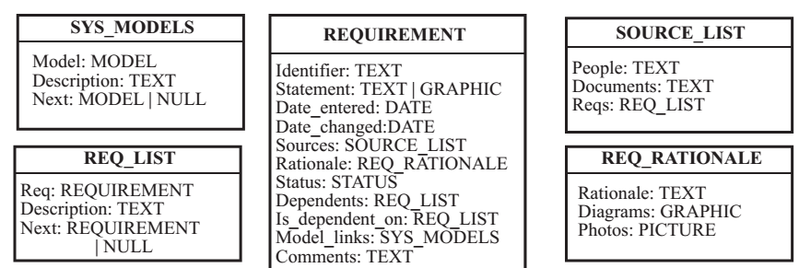
Object classes for requirements Database

Slide 17
Factors influencing the choice -Requirements DB
The statement of requirements:
If there is a need to store more than just simple text, a database with multimedia capabilities may have to be used.
The number of requirements:
Larger systems usually need a database which is designed to manage a very large volume of data running on a specialized database server.
Teamwork, team distribution and computer support:
If the requirements are developed by a distributed team of people, perhaps from different organizations, you need a database which provides for remote, multi-site access.
CASE tool use:
The database should be the same as or compatible with CASE tool databases. However, this can be a problem with some CASE tools which use their own proprietary database.
Existing database usage:
If a database for software engineering support is already in use, this should be used for requirements management.

Slide 18
Change management
Change management is concerned with the procedures, processes and standards which are used to manage changes to system requirements.
Change management policies may cover:
The change request process and the information required to process each change request.
The process used to analyze the impact and costs of change and the associated traceability information.
The membership of the body which formally considers change requests.
The software support (if any) for the change control process

Slide 19
The change management process
Some requirements problem is identified.
This could come from an analysis of the requirements, new customer needs, or operational problems with the system. The requirements are analyzed using problem information and requirements changes are proposed.
The proposed changes are analyzed.
This checks how many requirements (and, if necessary, system components) are affected by the change and roughly how much it would cost, in both time and money, to make the change.
The change is implemented.
A set of amendments to the requirements document or a new document version is produced. This should, of course, be validated using whatever normal quality checking procedures are used.

Slide 20
Stages in the change management process
Identified Revised
problem requirements
Problem analysis and change specification
Change analysis and costing
Change implementation

Slide 21
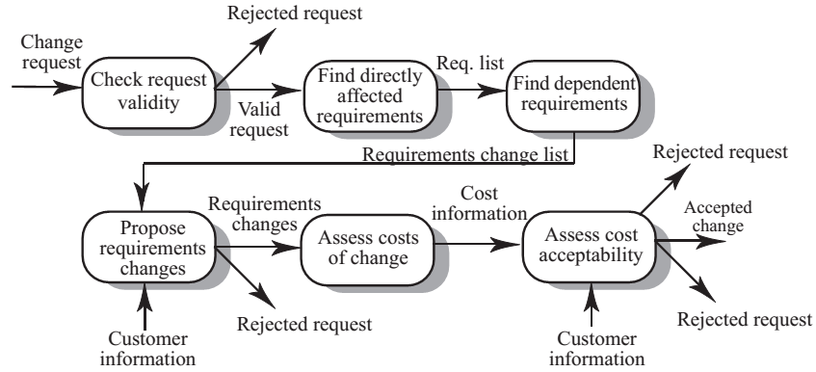
Change analysis and costing process

Slide 22
Change analysis activities
The change request is checked for validity. Customers can misunderstand requirements and suggest unnecessary changes.
The requirements which are directly affected by the change are discovered.
Traceability information is used to find dependent requirements affected by the change.
The actual changes which must be made to the requirements are proposed.
The costs of making the changes are estimated.
Negotiations with customers are held to check if the costs of the proposed changes are acceptable.

Slide 23
Change request rejection
If the change request is invalid. This normally arises if a customer has misunderstood something about the requirements and proposed a change which isn’t necessary.
If the change request results in consequential changes which are unacceptable to the user.
If the cost of implementing the change is too high or takes too long.

Slide 24
Change processing
Proposed changes are usually recorded on a change request form which is then passed to all of the people involved in the analysis of the change.
Change request forms may include:
fields to document the change analysis.
data fields.
responsibility fields.
status field.
comments field.

Slide 25
Tool support for change management
May be provided through requirements management tools or through configuration management tools.
Tool facilities may include:
Electronic change request forms which are filled in by different participants in the process.
A database to store and manage these forms.
A change model which may be instantiated so that people responsible for one stage of the process know who is responsible for the next process activity.
Electronic transfer of forms between people with different responsibilities and electronic mail notification when activities have been completed.
In some cases, direct links to a requirements database

Slide 26
Traceability
Traceability information is information which helps you assess the impact of requirements change. It links related requirements and the requirements and other system representations.
Types of traceability information:
Backward-from traceability Links requirements to their sources in other documents or people.
Forward-from traceability Links requirements to the design and implementation components.
Backward-to traceability Links design and implementation components backs to requirements.
Forward-to traceability Links other documents (which may have preceded the requirements document) to relevant requirements.

Slide 27
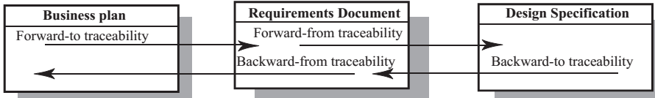
Backwards/forwards traceability

Slide 28
Types of traceability
Requirements-sources traceability
Links the requirement and the people or documents which specified the requirement.
Requirements-rationale traceability
Links the requirement with a description of why that requirement has been specified.
Requirements-requirements traceability
Links requirements with other requirements which are, in some way, dependent on them. This should be a two-way link (dependants and is-dependent on).
Requirements-architecture traceability
Links requirements with the sub-systems where these requirements are implemented. This is particularly important where sub-systems are being developed by different sub-contractors
Requirements-design traceability
Links requirements with specific hardware or software components in the system which are used to implement the requirement.
Requirements-interface traceability
Links requirements with the interfaces of external systems which are used in the provision of the requirements

Slide 29
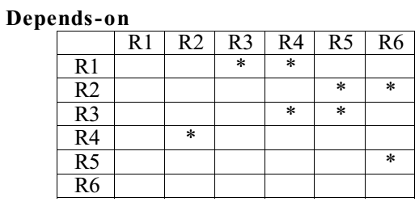
Traceability tables
Traceability tables show the relationships between requirements or between requirements and design components.
Requirements are listed along the horizontal and vertical axes and relationships between requirements are marked in the table cells.
Traceability tables for showing requirements dependencies should be defined with requirement numbers used to label the rows and columns of the tab

Slide 30
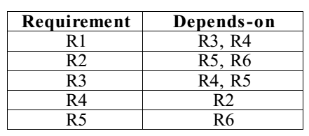
Traceability lists
If a relatively small number of requirements have to be managed (up to 250, say), traceability tables can be implemented using a spreadsheet.
Traceability tables become more of a problem when there are hundreds or thousands of requirements as the tables become large and sparsely populated.
A simplified form of traceability table may be used where, along with each requirement description, one or more lists of the identifiers of related requirements are maintained.
Traceability lists are simple lists of relationships which can be implemented as text or as simple tables.

Slide 31
Traceability policies
Traceability policies define what and how traceability information should be maintained.
Traceability policies may include:
The traceability information which should be maintained.
Techniques, such as traceability matrices, which should be used for maintaining traceability.
A description of when the traceability information should be collected during the requirements engineering and system development processes.
The roles of the people, such as the traceability manager, who are responsible for maintaining the traceability information should also be defined.
A description of how to handle and document policy exceptions.
The process of managing traceability information

Slide 32
Factors influencing traceability policy specialization
Number of requirements
The greater the number of requirements, the more the need for formal traceability policies.
Estimated system lifetime
More comprehensive traceability policies should be defined for systems which have a long lifetime.
Level of organizational maturity
Detailed traceability policies are most likely to be cost-effective in organizations which have a higher level of process maturity.
Project team size and composition
With a small team, it may be possible to assess the impact of proposed informally without structured traceability information. With larger teams, however, you need more formal traceability policies.
Type of system
Critical systems such as hard real-time control systems or safetycritical systems need more comprehensive traceability policies than non-critical systems.
Specific customer requirements
Some customers may specify that specific traceability information should be delivered as part of the system documentation

